Slide 1
Using natural history data as a comparator in an ultra-orphan disease indication
Peter Slasor, ScD BioMarin Pharmaceutical
November 7, 2019

Slide 2
outline
Ultra-rare Disease Setting: CLN2 Disease and the Clinical Development plan
Obtaining Breakthrough Therapy Designation (BTD)
BLA submission and discussions concerning retrospective NH data
Summary and Conclusions

Slide 3
Ultra-rare Disease Setting: CLN2 Disease and the Clinical Development plan

Slide 4
CLN2 Disease: Clinical program Planning
Challenges
Advantages
Ultra-rare
Only small N trials viable
Difficult to commit with limited evidence/POC
Potential high efficacy (Δ)
Enzyme replacement therapy
Severe disease, rapid progression
Few Publications
Active scientific community (DEMCHILD)
Existing NH database (N ~ 70)
No validated endpoints
Developing measures of motor & language
Within NH database

Slide 5
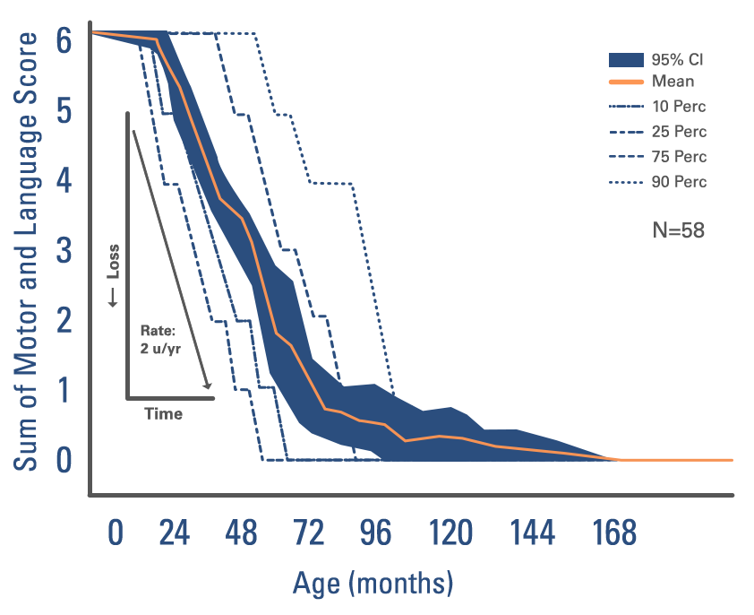
Natural History of CLN2 Disease: Children Decline ~2 points per Year in Motor-Language Score
MOTOR and LANGUAGE Assessments
Normal = 3
Abnormal = 2
Poor = 1
No function = 0
M + L {0 – 6}

Slide 6
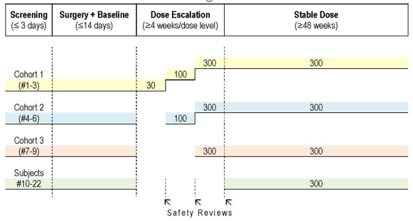
Clinical Development plan
A Phase 1/2 Open-Label Dose-Escalation Study to Evaluate Safety, Tolerability, Pharmacokinetics, and Efficacy of Intracerebroventricular BMN 190 in Patients with Late‑infantile Neuronal Ceroid Lipofuscinosis (CLN2) Disease
3
3
4
14
23 Completed / 24

Slide 7
Clinical development plan
Treated Population: Early and active:
Screening age ≥ 3 years
Screening ML score in the range 3 – 6
NH Population (Evaluable: N = 42)
age ≥3 years
≥2 ML scores, range 1 – 5, at least 6 months apart
Primary Endpoint: Mean slope of ML score
CSR: 1-sample T-test – Compare against fixed value “2”
ISE: 2-sample T-test – Treated versus NH (no matching)

Slide 8
Clinical Development plan
Look for early efficacy → negotiate with FDA
Breakthrough Therapy Designation
BLA filing on interim data
High Motivation - dog models very promising
- NH data available
- High Δ (3 year ML depletion)
- ERT in severe disease

Slide 9
Obtaining Breakthrough Therapy Designation (BTD)

Slide 10
Breakthrough Therapy Designation (BTD)
Objective – develop evidence needed to support approval – efficient as possible
Requirements – early clinical evidence drug provides substantial improvement on clinically significant endpoint
Effect on irreversible morbidity/mortality or severe symptoms
Effect on surrogate/intermediate endpoint likely to predict clinical benefit
Benefits
Efficient clinical development (all fast track benefits)
Intensive guidance as early as Phase I
Organization commitment involving senior managers

Slide 11
BTD – data looks
Look #1: 8 of 9 patients treated ≥ 12 months
Treatment: 0%
NH: 50%
P < 0.01
Month | 2-point ML Response
6 | 0/9 (0%)
9 | 1/9 (11%)
12 | 0/8 (0%)

Slide 12
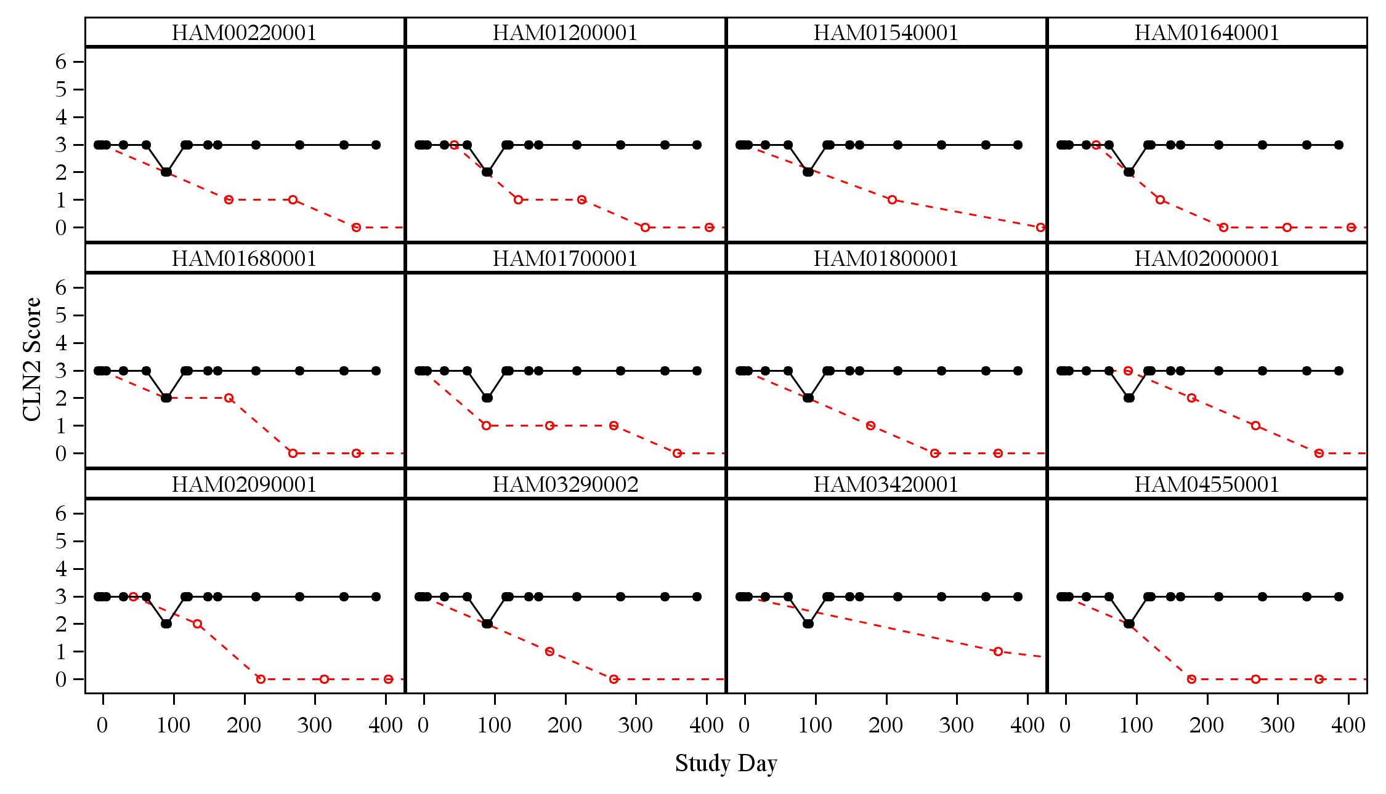
BTD – data looks
J.P. Morgan 2015
Look #1: Trial subject A
Control patient 1
Control patient 2
Control patient 3
Control patient 4
Control patient 5
Control patient 6
Control patient 7
Control patient 8
Control patient 9
Control patient 10
Control patient 11
Control patient 12
BMN 190 patient results
Natural history

Slide 13
BTD – data looks
Advice
Action
N and follow-up low
Update to Look #2: (N = 8 → 11)
NH includes retrospective data
Compare retrospective vs prospective
NH schedule less frequent than RX trial
Explore NH data (MMRM slope est.)
LOCF, baseline at diagnosis age
ML scale adapted from NH
Commensurate, PRO/DDT validation?
Plan for NH rater to assess videos of RX-ML assessments using NH criteria
Obtain additional NH databases
One smaller NH database contracted
Notes:
Most data is retrospective
Is it reasonable to combine M and L

Slide 14
BTD – data looks
Granted BTD
Denied interim data filing → complete the 48 week study
BTD Process Operational Challenges
High statistical & programming workload [Double Load]
Information requests concurrent with BLA preparation [interim data]
Requests included SAS datasets & exploratory data analyses
BTD decision needed to be finalized before SAP/CDP discussions
SAP comments received near BLA filing date – many changes

Slide 15
BLA submission & discussions concerning retrospective Natural History data

Slide 16
BLA overview / Timeline
~ 5 years from first scientific meetings to approval
~ 3.5 years from FPI to approval
~ 2.25 years Clinical trial
CDP design | Accrual | LPO | DBL to BLA approval
65 Weeks | 69 Weeks | 48 Weeks | 73 Weeks

Slide 17
Bla Discussions
Advice/changes generally accepted
High efficacy seen at time of BLA filing & expedience
Time to ML decline (2-pt drop or zero)
75% slope
Reduction
(matched)
NH | RX
2.06 | 0.53
HR = 0.10
(0.03, 0.38)

Slide 18
Bla Discussions
Change | SAP | Pre-BLA changes | Post-BLA changes
N (24 treated) | N=21: 1 ET X 2 asym X | N=23: 1 ET X 2 asym √ | N=22: 1 ET √ 2 asym X
Impute failure
primary endpoint | Primary ML slope Responder supportive | Responder ML 2pt drop or 0 | Responder M 2pt drop or 0
Inter-rater (video) questioned L
population / matching | Full population no matching N=(42, 24) | Match 1 – 1 ML, age ≤12 N=(21, 21) | Match 1 – 1 ML, age ≤3, gene N=(17, 17)
Reduced
N & power
Analysis method for responder | Fisher Exact |  | McNemar
R ~ 0
Assessment Schedule |  | Supportive slopes analysis with LOCF | All analyses use LOCF to RX grid
Imputes flatness NH
Generalizability |  |  | Cox Models on Full population
 |  | Consider M.I.
We should have !!

Slide 19
Bla Discussions
Many changes!
BTD Senior Manager Review Pressure Update
Retrospective Data Test FU
Updates considered substantial amendment: PDUFA date pushed 3 months
LOCF conservative analyses could only be overcome with updated data
Notes:
Would we accept these advice without having efficacy results in hand?
Won’t go into ML to M change

Slide 20
1 – 1 matching
Matching can reduce bias and heterogeneity
Choose variables predicting ML slope / propensity score matching
Want high match percentage ( age ≤ 12 months apart, equal ML )
Specify in SAP before first treated follow-up visit
Mean ML Decline
Population | NH | Treated | Correlation
Full N = (42, 23) | 2.12 | 0.20
Matched N = (21, 21) | 2.05 | 0.24 | -0.025
We had not planned to match due to no known covariates predictive of disease

Slide 21
Looking back
Protracted discussion period → Eroded Power
Simple responder analysis
Matching (reduced N)
LOCF
More careful decisions on SAP (ex. Missing data)
Earlier SAP discussion
Understand the Regulatory Authority (ex. “why do you ask for MMRM with LOCF?”)
Drop early BLA file plan / interim data – will not show well with LOCF

Slide 22
Looking back
Other Lessons
Use many NH data sources and justify selection
Own / audit NH data
Every data point matters when N is small / 100% audit & clean key data
PRO instruments require validation (or concurrent pilot study).
Video of assessments is good back-up plan (inter-rater reliability)
Keep trial endpoints as similar to retrospective NH data as possible (resist improvements)

Slide 23
Power revised endpoints – PROTOCOL / ISE
If efficacy result not available ?
Protocol Assumptions
75% Slope Reduction
NH 2pt loss per 48 Weeks
48 Week Failure Rate
NH 50%
RX 20%
METHOD Fisher Exact
Not Matched (Full Sample) N=(42,23)
62%
1-1 Match BL, age≤12 N=(21,21)
41%
1-1 Match BL, age≤3, gene N=(17,17)
32%
Impute W.C. For Early Term N=(18,18)
24%
METHOD McNemer Exact
Assumes pairs not correlated
Power loss ~ delete one pair
1-1 Match BL, age≤3, gene N=(17,17)
29%
Impute W.C. For Early Term N=(18,18)
20%
Notes:
Variability of difference in matched pair > variability of difference in matched pair under random matching
2 x 2 table for matched pair had the minimum possible concordance

Slide 24
Power for revised endpoints: actual
48 Week (protocol)
NH 50%
RX 20%
48 Week (actual)
NH 51%
RX 9%
METHOD Fisher Exact
Not Matched (Full Sample) N=(42,23)
62% → 94%
1-1 Match BL, age≤12 N=(21,21)
41% → 79%
1-1 Match BL, age≤3, gene N=(17,17)
32% → 66%
Impute W.C. For Early Term N=(18,18)
24% → 52%
METHOD McNemer Exact
LOCF-W48 ↓ power to near 0
Complete FU through Week 96 to overcome LOCF
1-1 Match BL, age≤3, gene N=(17,17)
29% → 61%
Impute W.C. For Early Term N=(18,18)
20% → 47%

Slide 25
Summary and Conclusions

Slide 26
Summary
BLA approved with substantial amendment – extra 3 months
NH data (exists) & BTD approval likely facilitated (early) BLA approval
Power of original design lost due to concerns non-randomized, non-prospective NH
Matching reduced N - failed to reduce heterogeneity
Different schedules (LOCF to W48)
CONCEPTUAL
Randomized 16 x 2 trial has equal power. +10 wks (+23 accrual -13 substantial amd)
Must assume high efficacy (risk)
Need NH for assessing longer term efficacy ( Control → RX @ W48 )
Treated experience ↓ @ BTD discussions. BTD successful? Necessary?
Clean and fewer analyses

Slide 27
conclusions
Randomized is best, and might not be slower (if high efficacy assumed). Risk?
Prospective >> Retrospective (challenging).
Link early with Sci. Comm. / academic groups
Design prospective NH studies / validate endpoints (or semi-validate)
Encourage Sci. Comm. to proceed as if an industry partner is available
Validate endpoints for regulatory use
Expect high hurdles retrospective NH
Matching ( ↓ power )
Conservative LOCF ( ↓ power )
Longer FU
Careful Pace (planning):
Early FDA & real discussions
better endpoints – TTE, recurrent
Improved imputation from LOCF
[ file BLA interim data ]

Slide 28
Thank you !

